Slide 1
Stand-up meeting
03/02/2021

Slide 2
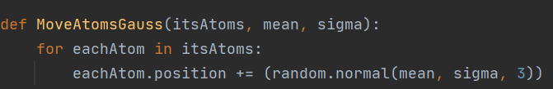
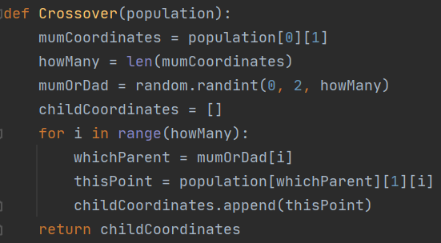
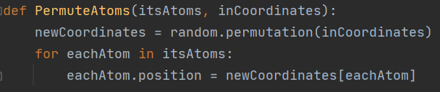
Evolutionary algorithm removed!
The PerAtom EA was found to perform better and faster without being an EA at all! The ManyMolecule EA is still an EA. Evolutionary functions were removed from the PerAtom algorithm but remain in the shared module of evolutionary functions. Some examples below…
And so on…..

Slide 3
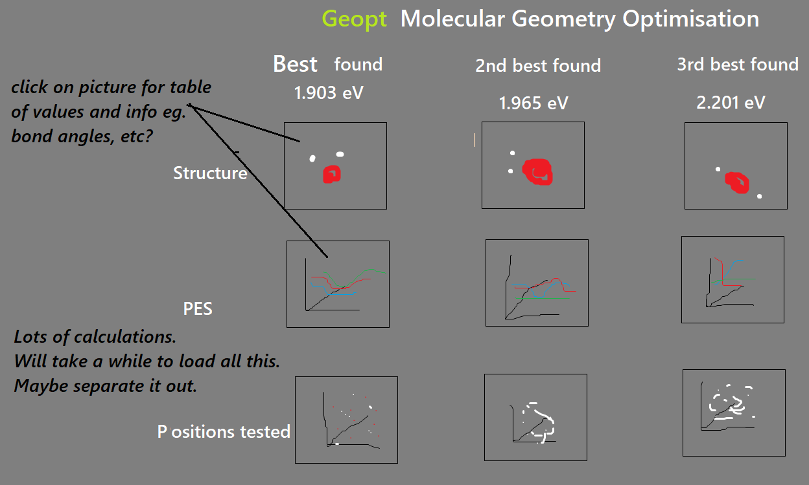
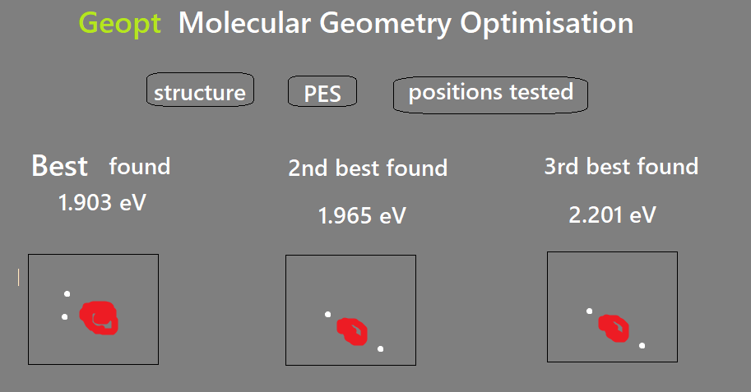
Sprint 4. User story: I wish to view molecule, info & PES
Planned a UI layout in Tkinter. Made a few plans & storyboards. E.g….

Slide 4
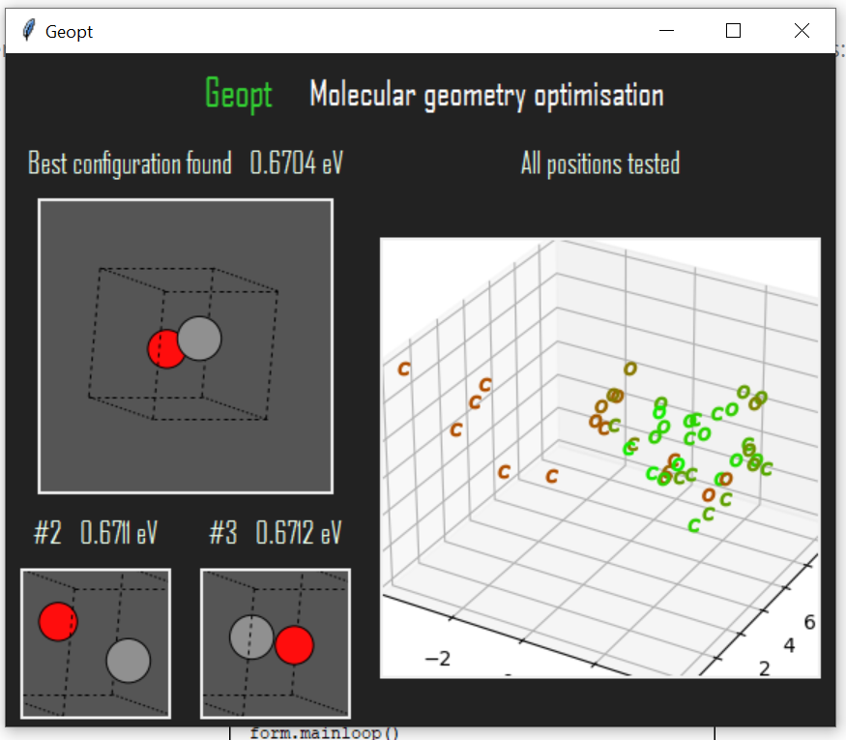
Sprint 4. User story: I wish to view molecule, info & PES
Made a plot of all tested positions of atoms in the molecule. This shows where the algorithm tried placing them during its evolution. Points were labelled according to atom symbol and scaled and coloured according to energy.

Slide 5
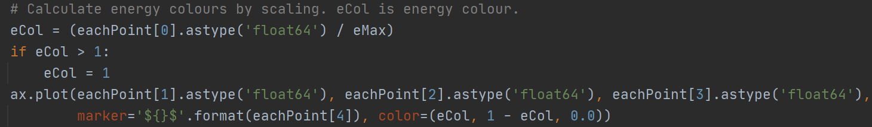
Sprint 4. User story: I wish to view molecule, info & PES
Tried standardisation, minmax scaler etc but came up with my own version because it was simpler. It is just energy / highest energy.
Subtracts that number from green and add it to red for energy scale.

Slide 6
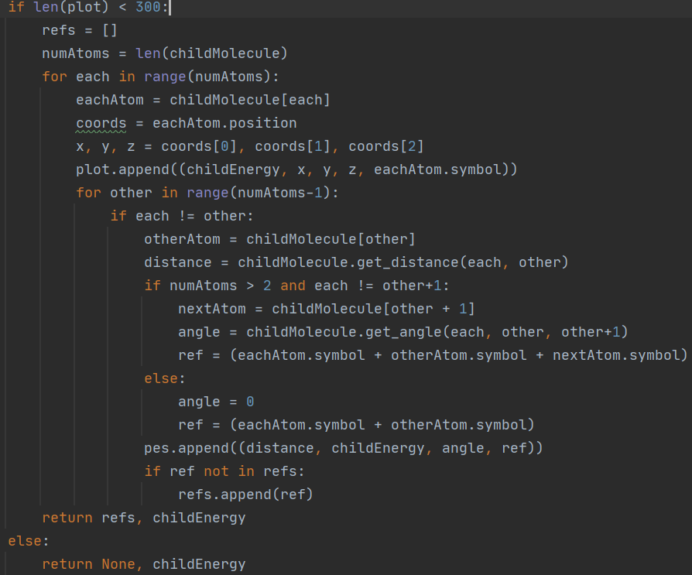
Sprint 4. User story: I wish to view molecule, info & PES
Build up datasets
for plots and stats
while the algorithms
are running.
Many different
things computed
inside same loops.
Code is not so
separable (not as
SOLID) but it is
faster to execute.

Slide 7
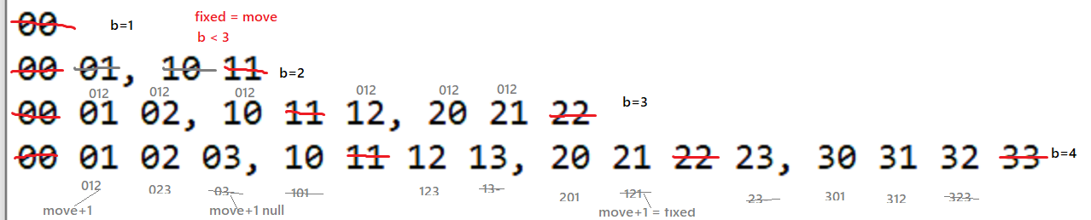
Sprint 4. User story: I wish to view molecule, info & PES
Planned potential energy surface plots (PES).
3d plot of angle over 3 atoms, distance between 2 of those 3 atoms and the total potential energy of the molecule.
Difficult because each axis has a different number of variables. An example of me getting confused while planning it…

Slide 8
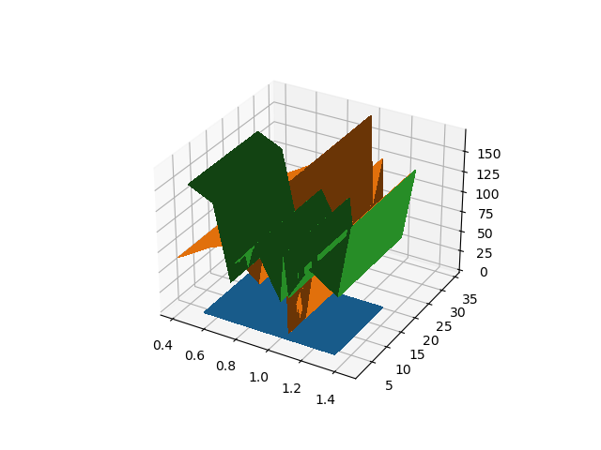
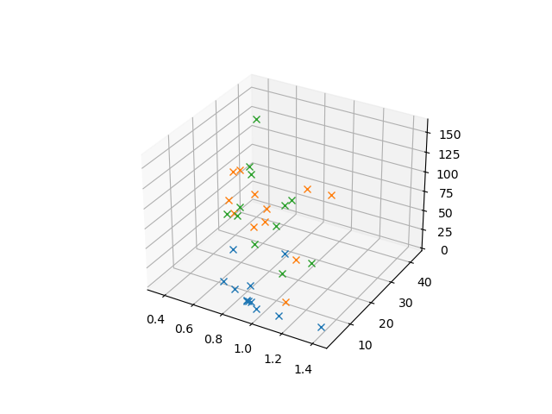
Sprint 4. User story: I wish to view molecule, info & PES
PES first attempts didn’t go to plan…
Tri-surface plots were found to be better than surface plots with mesh-grids or wire-frames.
This is because of the vast variation in data points.

Slide 9
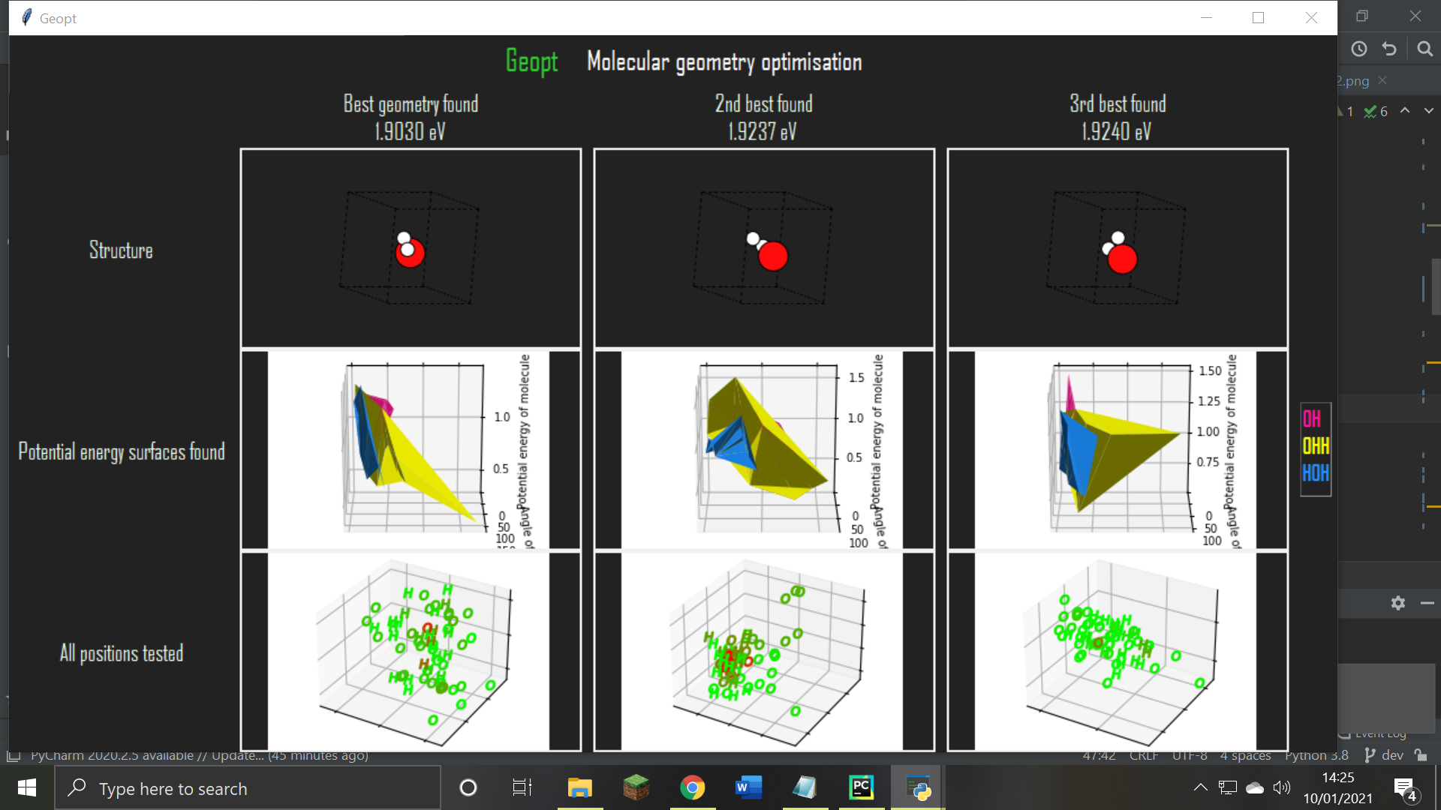
Sprint 4. User story: I wish to view molecule, info & PES
My original layout was cramped and not everything fitted on the page so I redesigned the whole thing and started again.

Slide 10
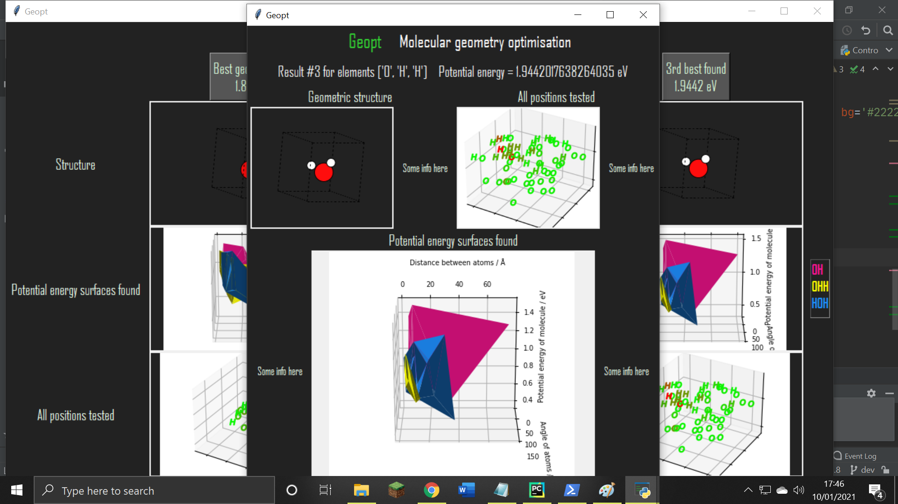
Sprint 4. User story: I wish to view molecule, info & PES
The new design included an extra info window for each version on the molecule.

Slide 11
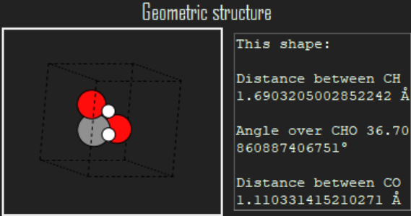
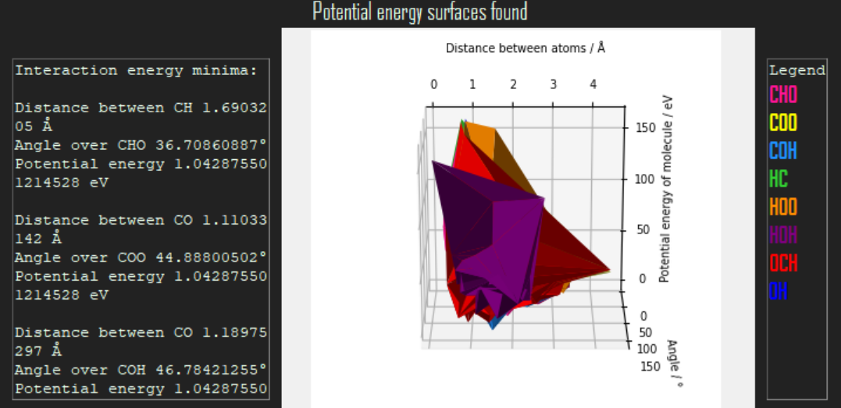
Sprint 4. User story: I wish to view molecule, info & PES
Utilised the datasets created earlier to display lots of useful information to the user.

Slide 12
Sprint 5. Usability tests, feedback & improvements.
Conducted 3 usability tests; one with a chemist and two with computer scientists.
Got lots of useful feedback.
Acted on it.

Slide 13
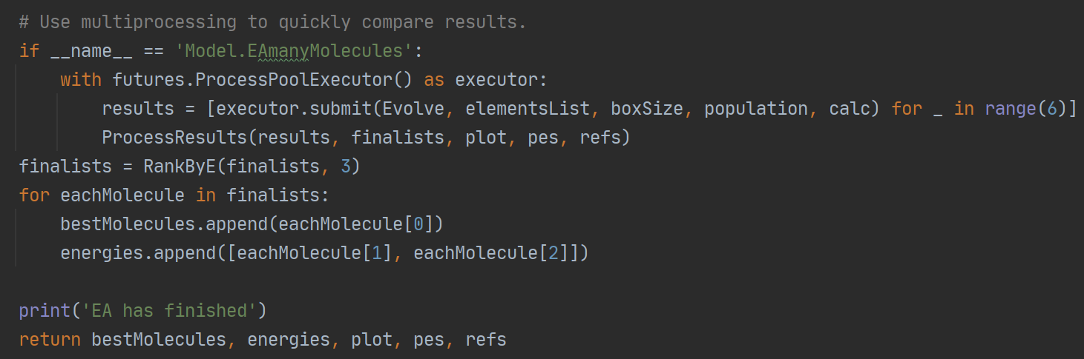
Sprint 5. Usability tests, feedback & improvements.
Feedback – it takes too long!
Actions – Implemented multiprocessing, limited number of iterations, limited plot dataset sizes, made some code optimisations.

Slide 14
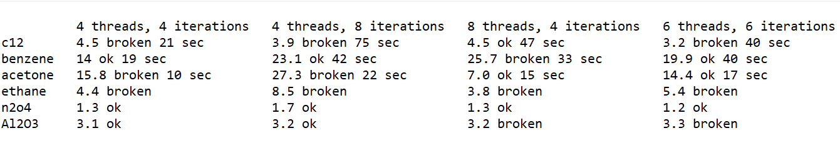
Sprint 5. Usability tests, feedback & improvements
Found the best set of parameters for multiprocessing by trial & error.
It uses 6 at the moment because my PC has 6 cores. In the future, I would like to adapt this to the PC and, preferably, use the GPU.
‘Broken’ means the structure of the molecule is chemically wrong.
They’re not technically ‘threads’ but I called them that for clarity.

Slide 15
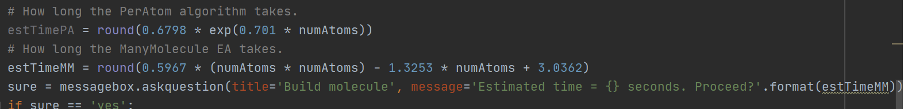
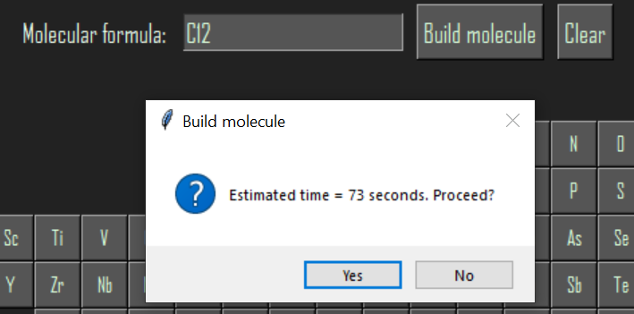
Sprint 5 Usability tests, feedback & improvements
Feedback – I thought the program had frozen!
Actions – Let the user know how long it will take.

Slide 16
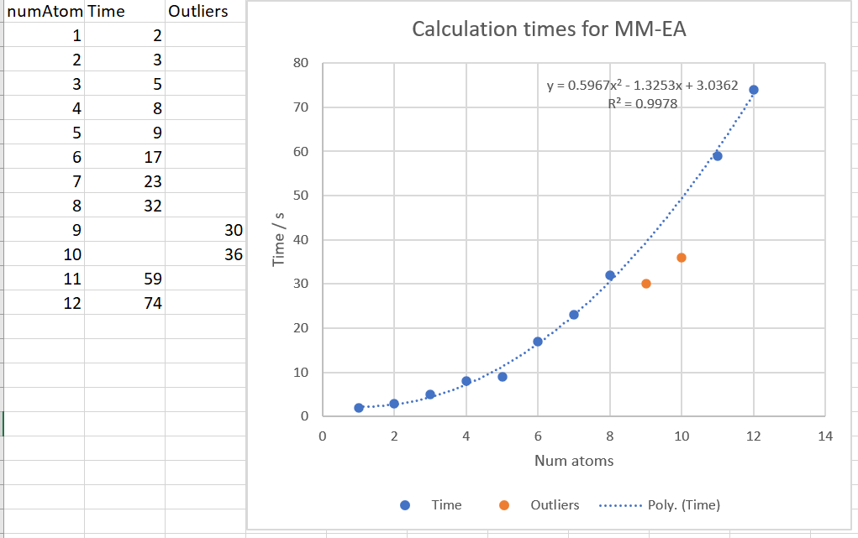
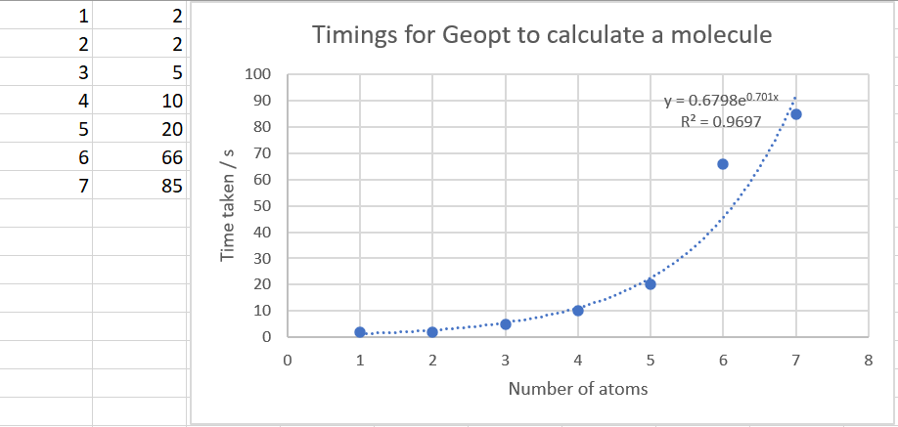
Sprint 5 Usability tests, feedback & improvements
How long it actually takes:
The EA is faster than the PerAtom algorithm at the moment.
I still hope to improve them both.

